Slide 1

UNIVERSITY INSTITUTE OF ENGINEERING
COMPUTER SCIENCE ENGINEERING
Master of Engineering
ADVANCED DATA STRUCTURES
&
ALGORITHMS
(23CSH-622)
By: Dr. Ranjit Singh (E10947)
INTRODUCTION
DISCOVER . LEARN . EMPOWER

Slide 2
Contents of the Syllabus
UNIT-I (15h)
Introduction to Basic Data Structures: Importance and need of good data structures and algorithms, Introduction to linear and non-linear data structure and its importance, Algorithms Complexity and Analysis. [3]
Linear and Non –Linear Data Structures : Arrays , Link Lists, Queues , Trees and related algorithms [6]
Advanced Data Structures: AVL Trees (Insertion , Deletion , Searching), Red-Black Trees, B-trees, B+trees, Heaps. Data structure for disjoint sets, Augmented data structures. [6]
UNIT-II (15h)
Searching and Sorting : Internal and External Sorting algorithms: Linear Search, Binary Search, Bubble Sort, Selection Sort, Insertion Sort, Shell Sort, Quick Sort, Heap Sort, Merge Sort, Counting Sort, Radix Sort and analysis of their complexities and Hashing [4]
Graphs & Algorithms: Representation, Type of Graphs, Depth- and breadth-first traversals, Planar graphs, isomorphism, graph coloring, covering and partition, Minimum Spanning Tree: Prim’s and Kruskal’s algorithms. [6]
String Matching Algorithms: Naïve String Matching, Suffix arrays, Suffix trees, Rabin-Karp, Knuth-Morris-Pratt, Booyer-Moore algorithm [5]

Slide 3
Contents of the Syllabus
UNIT-III (15h)
Approximation algorithms: Need of approximation algorithms: Introduction to P, NP, NP-Hard and NP-Complete Greedy Approach , Dynamic Approach , Knapsack, Huffman Coding, TSP, All pair shortest path, Longest Common Subsequence Problem, Matrix Chain Multiplication. [7]
Randomized algorithms: Introduction, type of randomized algorithms, Quick sort, min cut [4]
Online Algorithms: Introduction, Online Paging Problem, k-server Problem. Data compression: Huffman’s coding, BWT, LZW [4]
Recommended Books:
1. Cormen, Leiserson, Rivest, Stein, “Introduction to Algorithms”, Prentice Hall of India, 3rd edition 2012.
2. Horowitz, Sahni and Rajasekaran, “Fundamental of Computer, Algorithms”, University Press (India), 2nd edition.
3. Aho, Haperoft and Ullman, “The Design and analysis of Computer Algorithms”, Pearson Education India.

Slide 4
String matching
Given a pattern string P of length m and a string S of length n, find all locations where P occurs in S
P = ABA
S = DCABABBABABA

Slide 5
String matching
Given a pattern string P of length m and a string S of length n, find all locations where P occurs in S
P = ABA
S = DCABABBABABA

Slide 6
Applications
Text editors
Search engines
Biological research

Slide 7
Uses
grep/egrep
search
find
java.lang.String.contains()

Slide 8
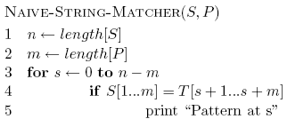
Naive implementation

Slide 9
Running time?
Best case
?
Worst case
?

Slide 10
Running time?
Best case
Θ(n) – when ?
Worst case
O((n-m+1)m)

Slide 11
Running time?
Best case
Θ(n) – when the first character of the pattern does not occur in the string
Worst case
O((n-m+1)m) When ?

Slide 12
Worst case
P = AAAA
S = AAAAAAAAAAAAA

Slide 13
Worst case
P = AAAA
S = AAAAAAAAAAAAA

Slide 14
Worst case
P = AAAA
S = AAAAAAAAAAAAA

Slide 15
Worst case
P = AAAA
S = AAAAAAAAAAAAA
repeated work!

Slide 16
Rabin-Karp algorithm

Slide 17
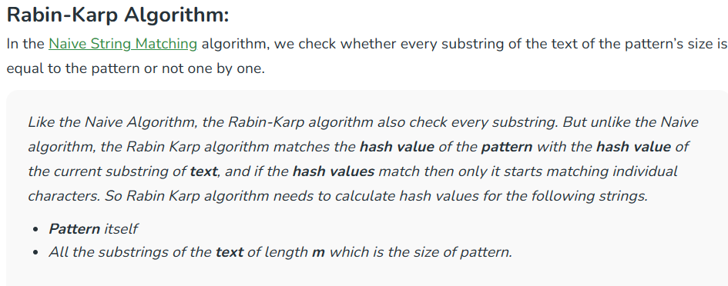

Slide 18
Rabin-Karp algorithm
- Use a function T to that computes a numerical representation of P - Calculate T for all m symbol sequences of S and compare
P = ABA
S = BABABBABABA

Slide 19
Rabin-Karp algorithm
- Use a function T to that computes a numerical representation of P - Calculate T for all m symbol sequences of S and compare
P = ABA
Hash P
T(P)
S = BABABBABABA

Slide 20
Rabin-Karp algorithm
- Use a function T to that computes a numerical representation of P - Calculate T for all m symbol sequences of S and compare
P = ABA
S = BABABBABABA
Hash m symbol sequences and compare
T(BAB)
=
T(P)

Slide 21
Rabin-Karp algorithm
- Use a function T to that computes a numerical representation of P - Calculate T for all m symbol sequences of S and compare
P = ABA
match
S = BABABBABABA
Hash m symbol sequences and compare
T(ABA)
=
T(P)

Slide 22
Rabin-Karp algorithm
- Use a function T to that computes a numerical representation of P - Calculate T for all m symbol sequences of S and compare
P = ABA
S = BABABBABABA
Hash m symbol sequences and compare
T(BAB)
=
T(P)

Slide 23
Rabin-Karp algorithm
- Use a function T to that computes a numerical representation of P - Calculate T for all m symbol sequences of S and compare
P = ABA
For this to be useful/efficient, what needs to be true about T?
S = BABABBABABA
…
T(ABB)
=
T(P)

Slide 24
Rabin-Karp algorithm
For this to be useful/efficient, what needs to be true about T?
P = ABA
Given T(s_{i…i+m-1}) we must be able to efficiently calculate T(s_{i+1…i+m})
S = BABABBABABA
…
T(ABB)
=
T(P)

Slide 25
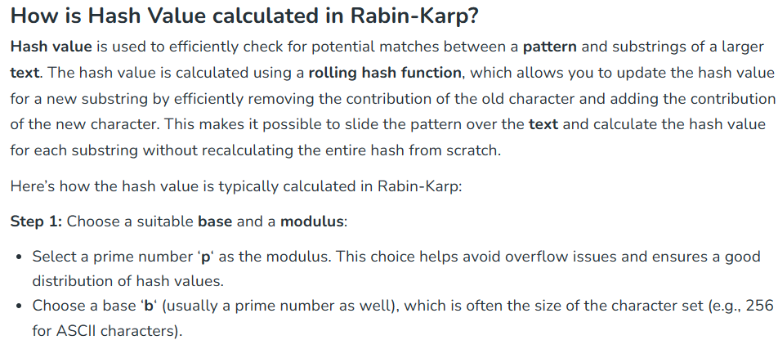

Slide 26
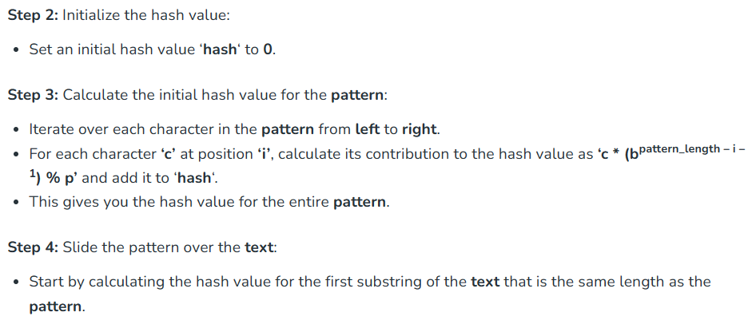

Slide 27
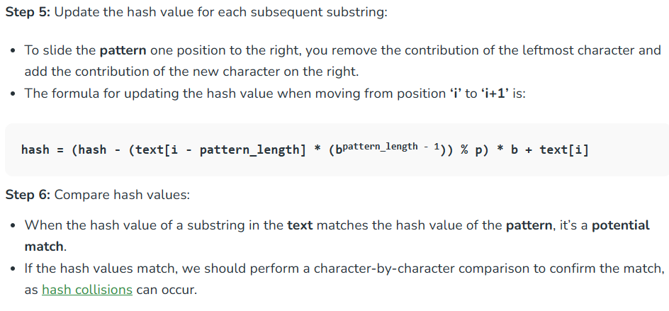

Slide 28
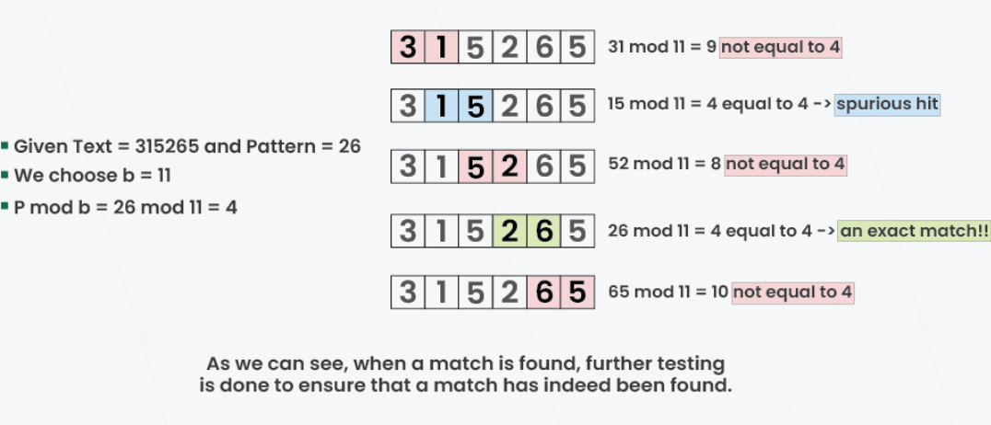

Slide 29
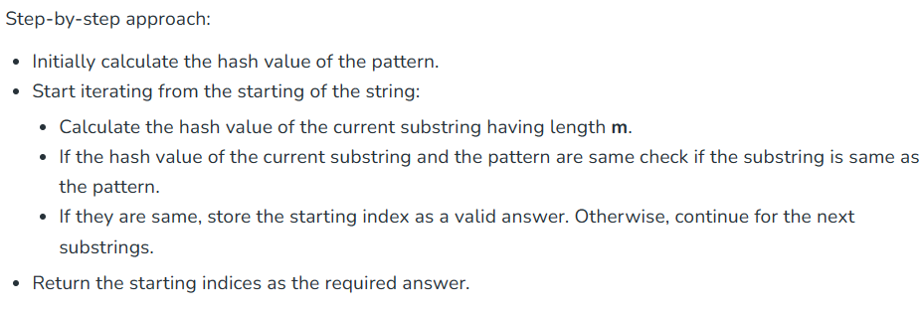

Slide 30
KMP Algorithm

Slide 31
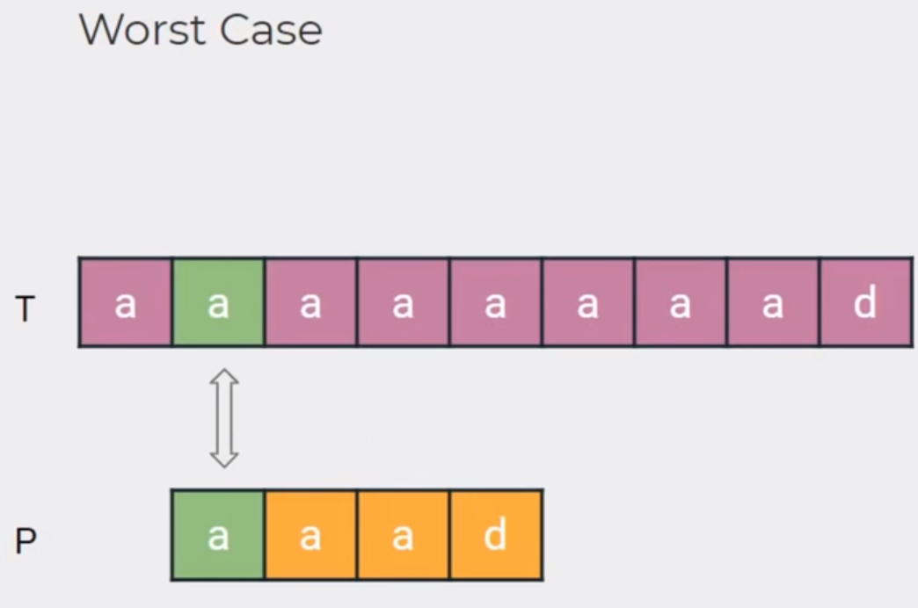

Slide 32
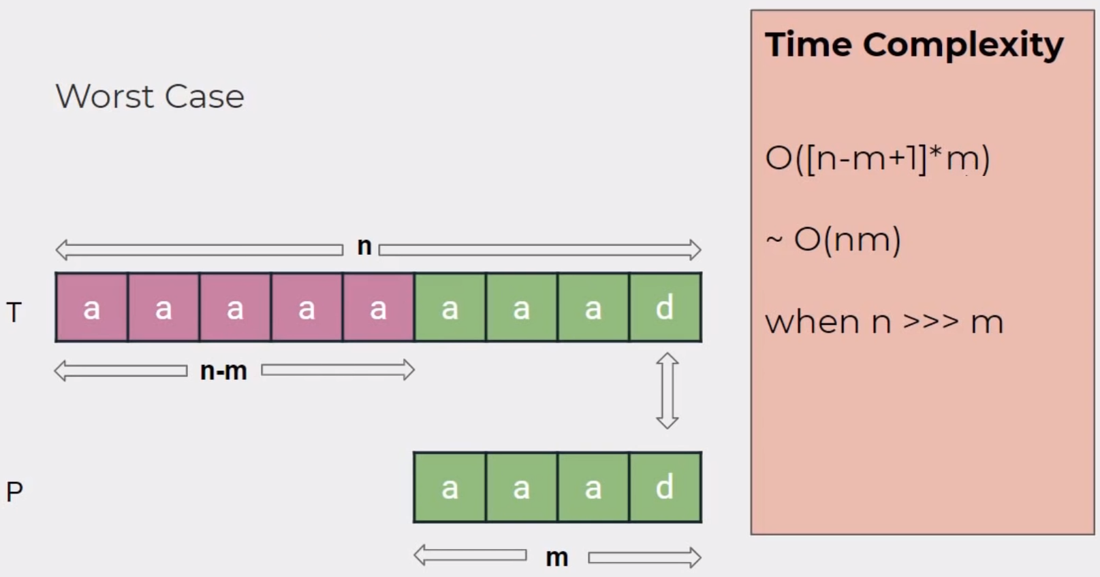

Slide 33
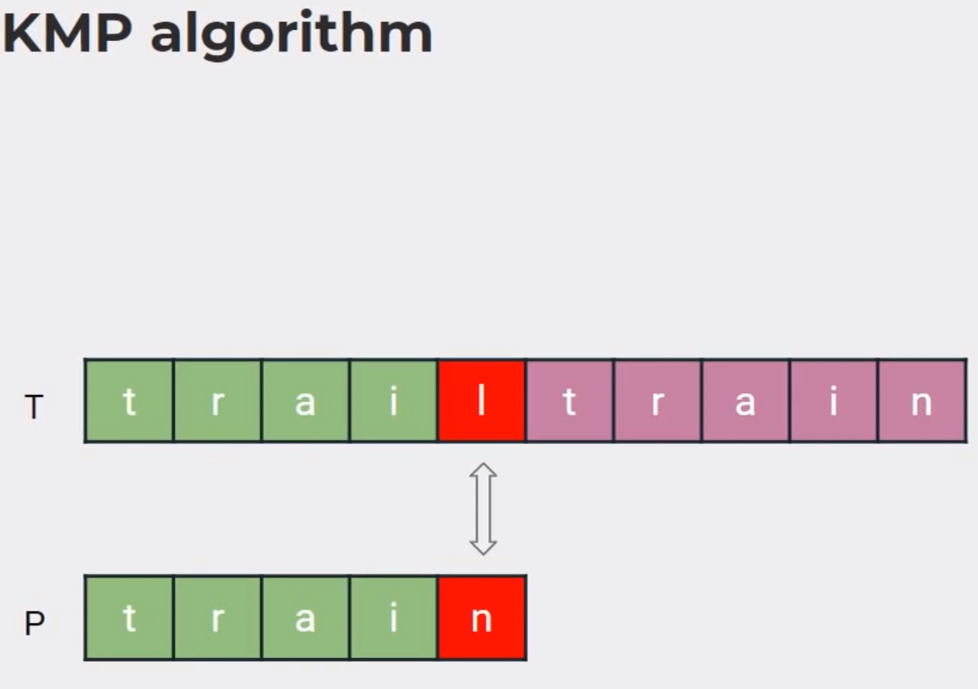

Slide 34
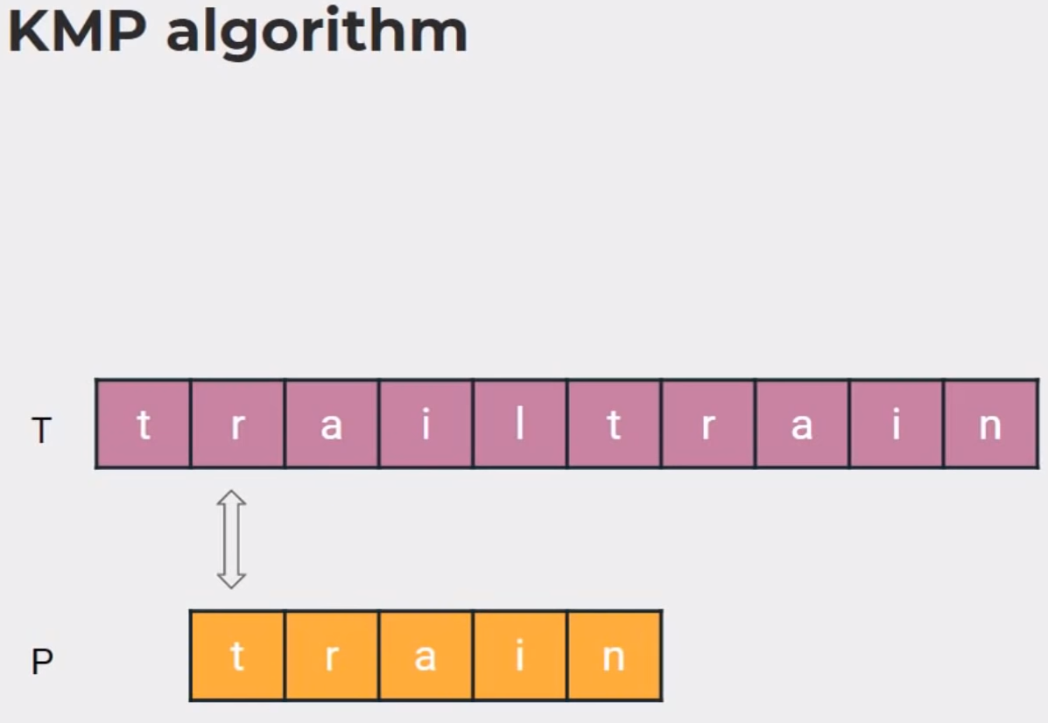

Slide 35
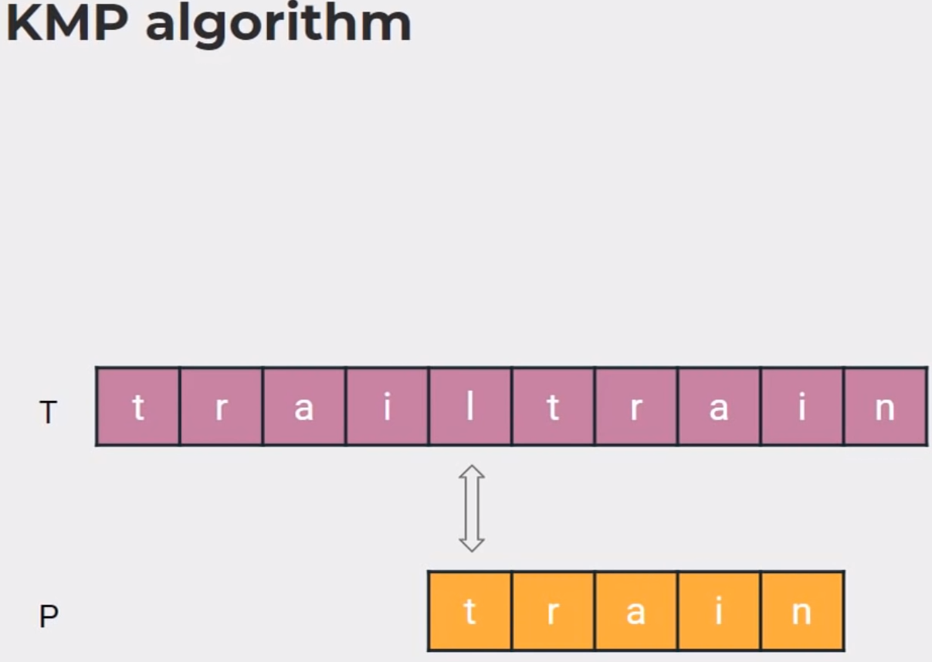

Slide 36
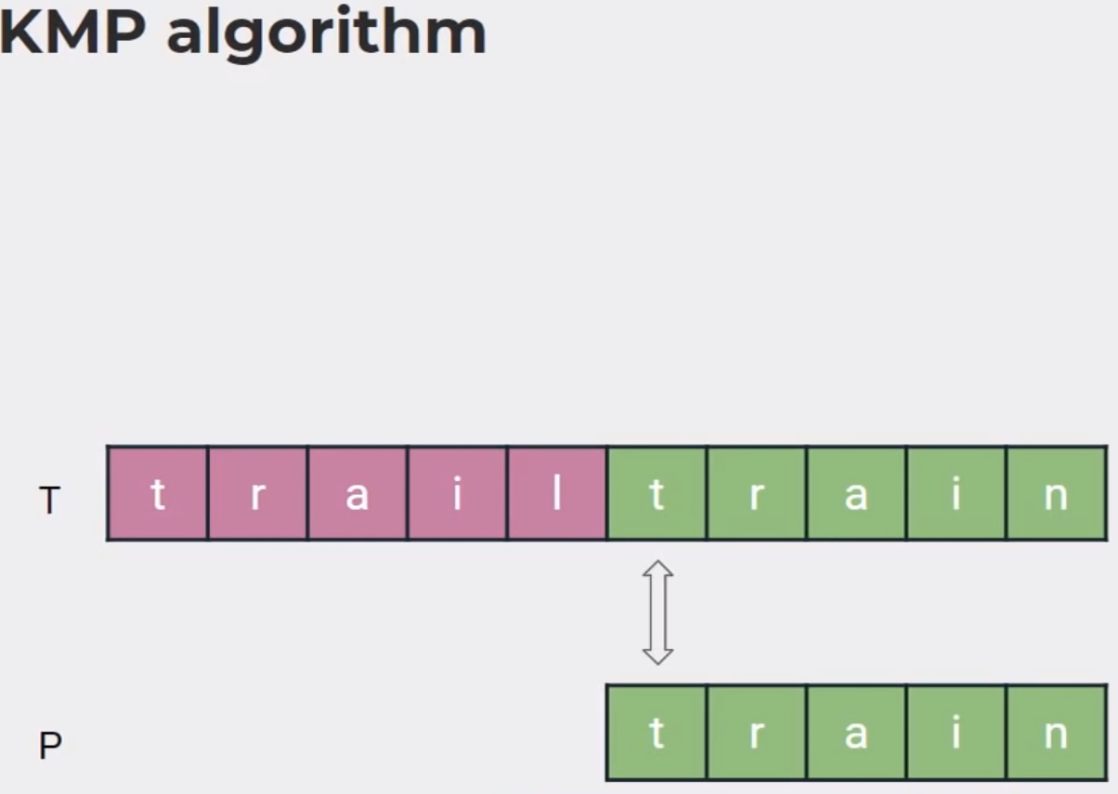

Slide 37
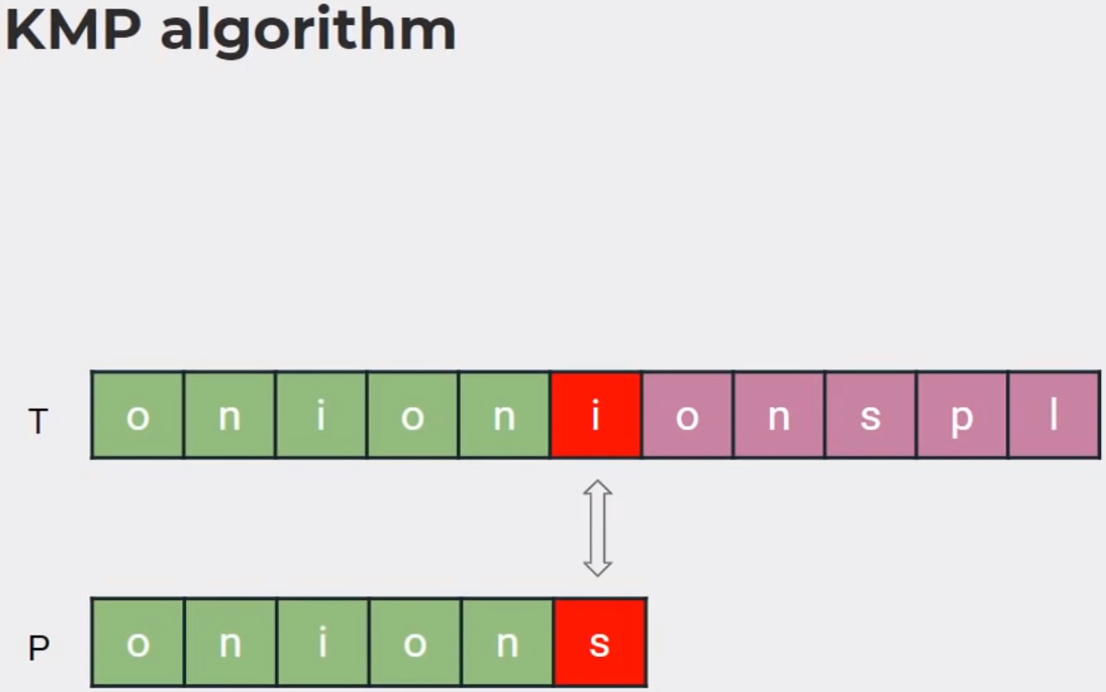

Slide 38
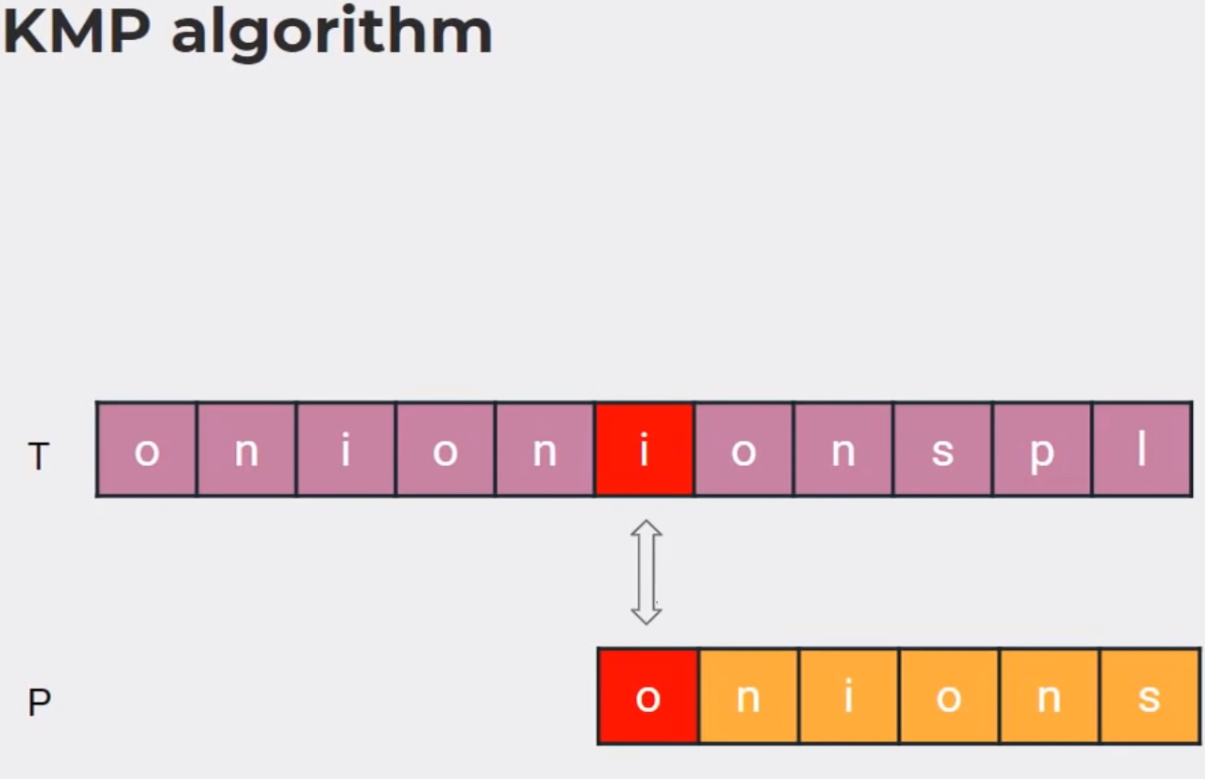

Slide 39
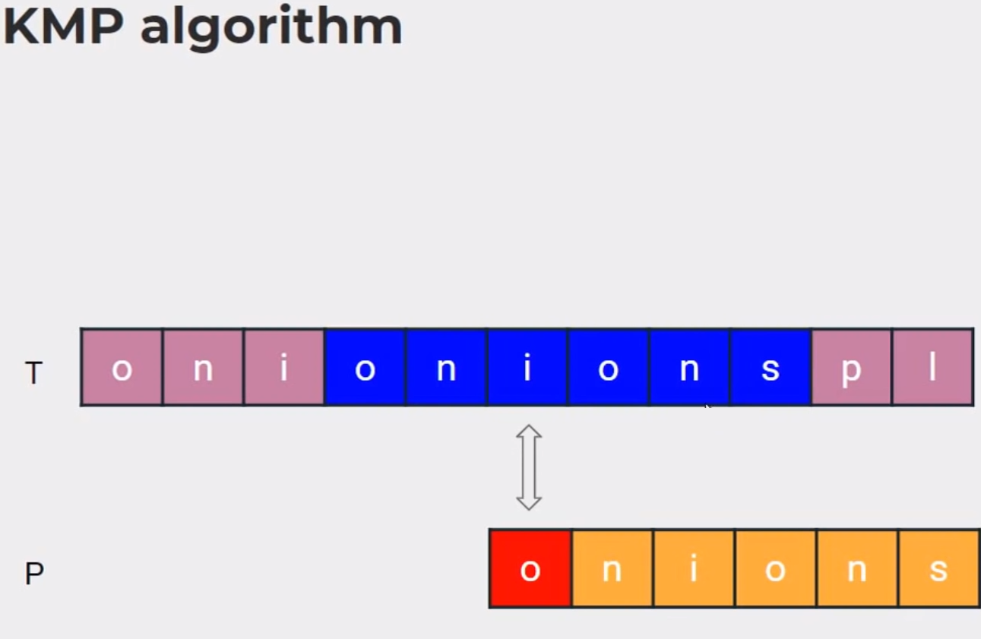

Slide 40
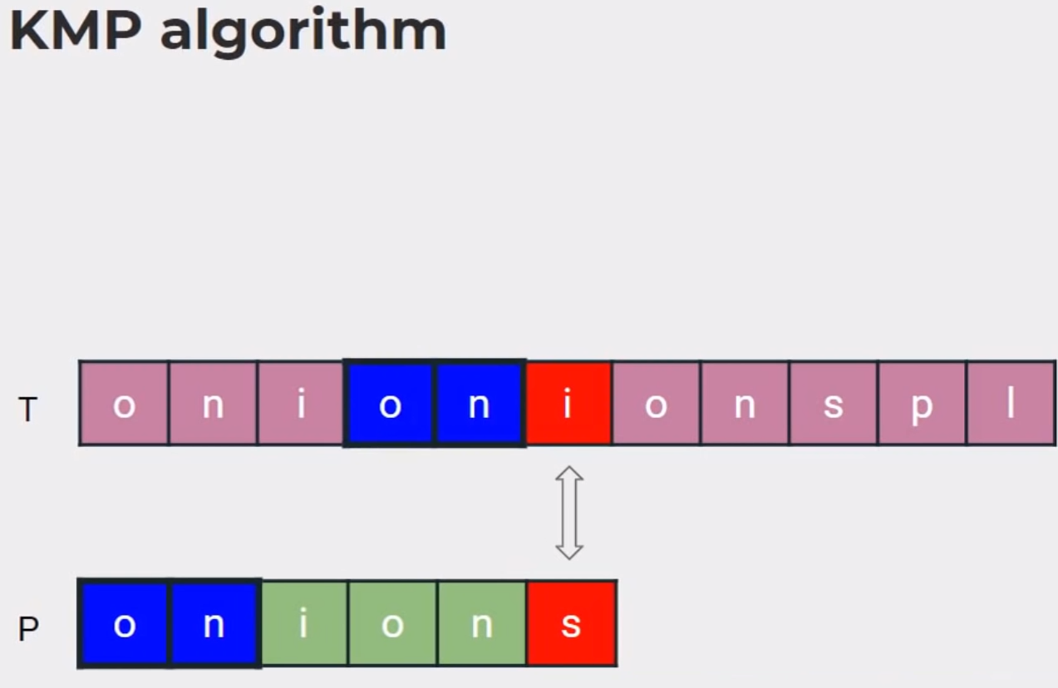

Slide 41
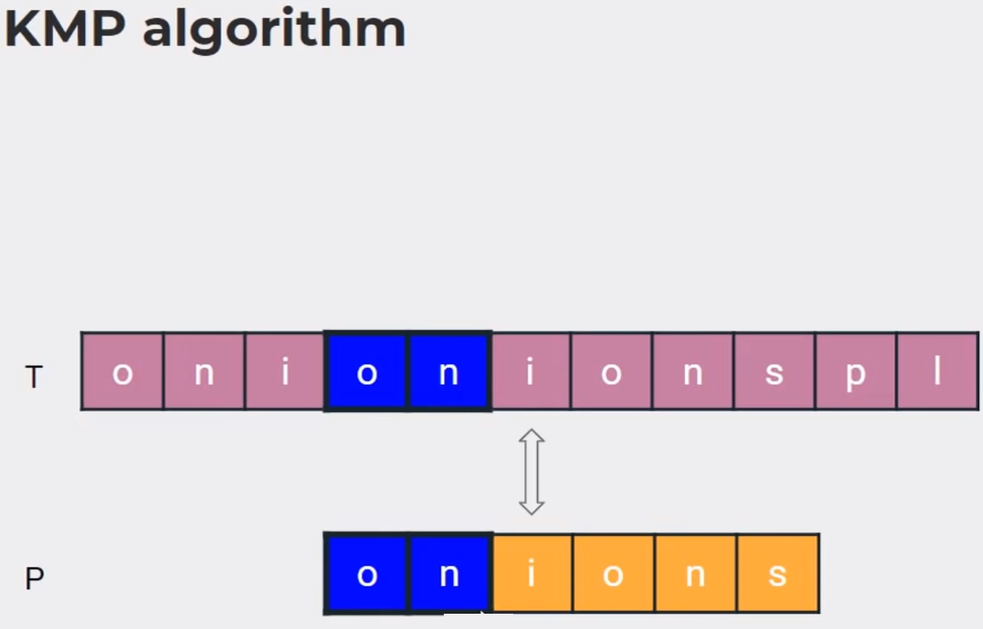

Slide 42
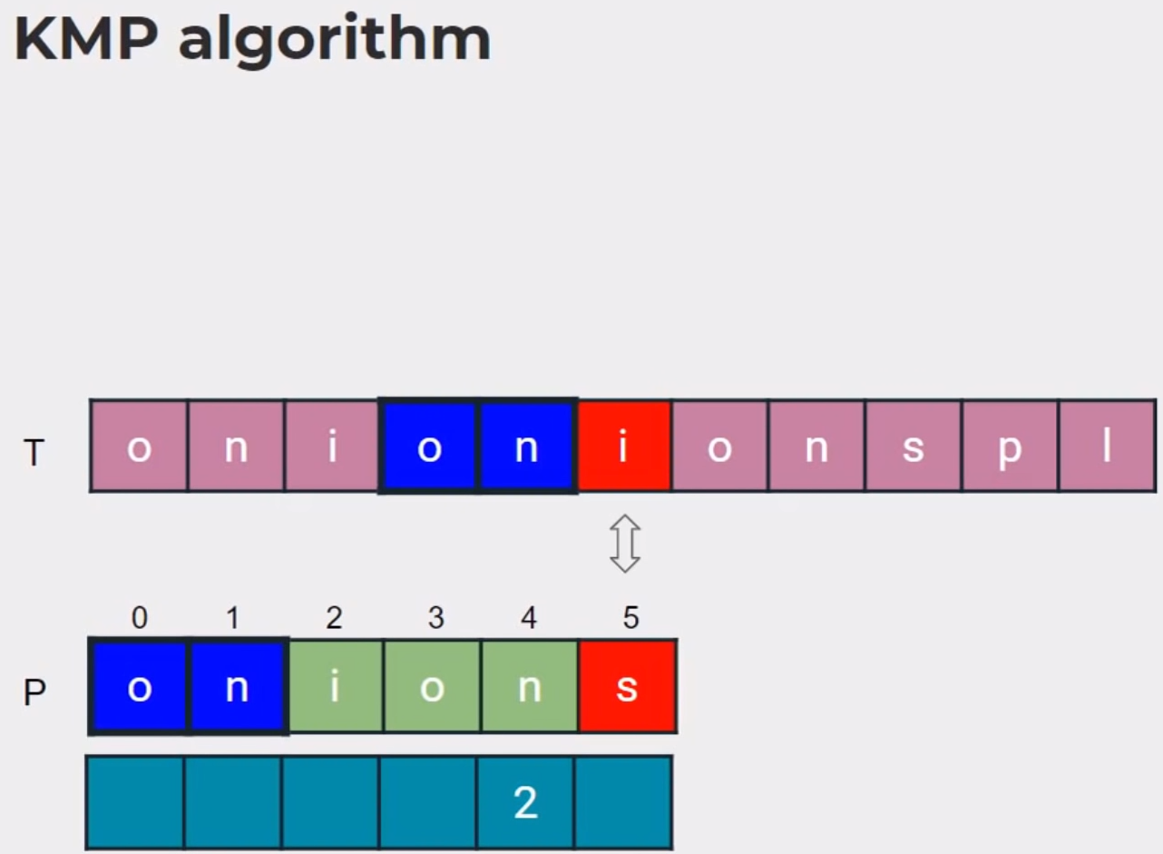

Slide 43
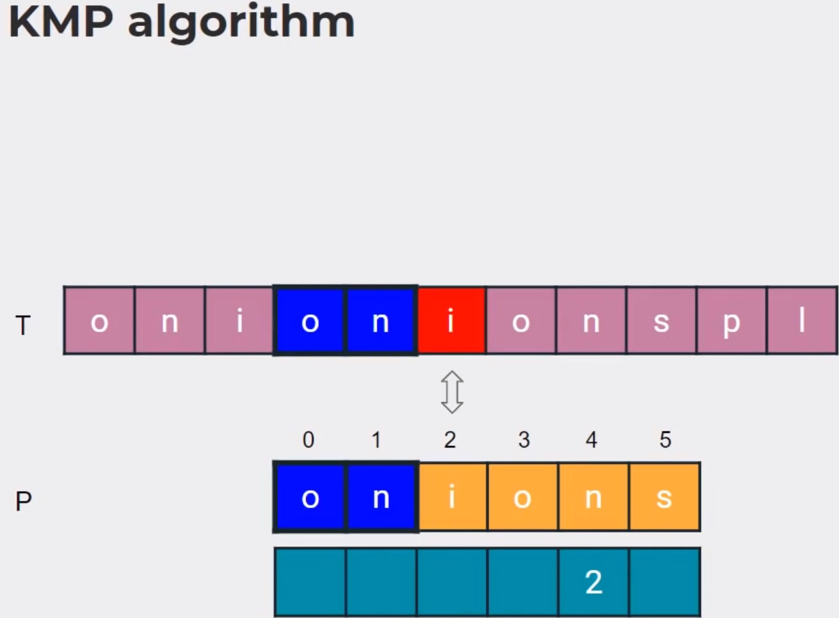

Slide 44
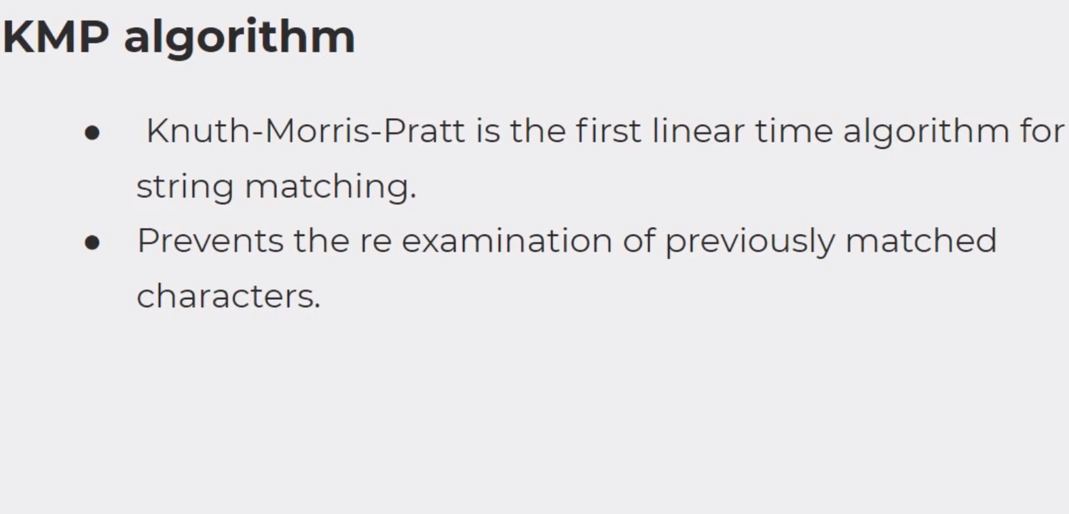

Slide 45
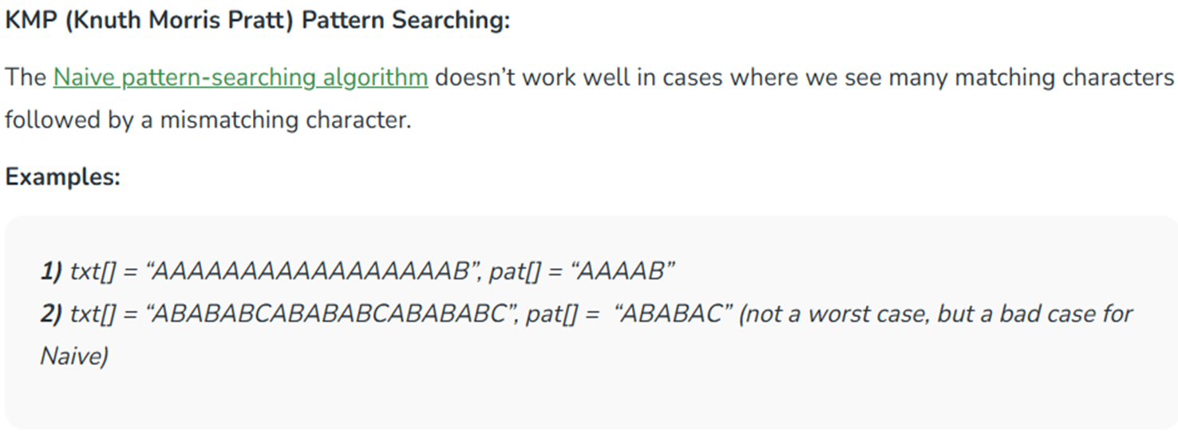

Slide 46
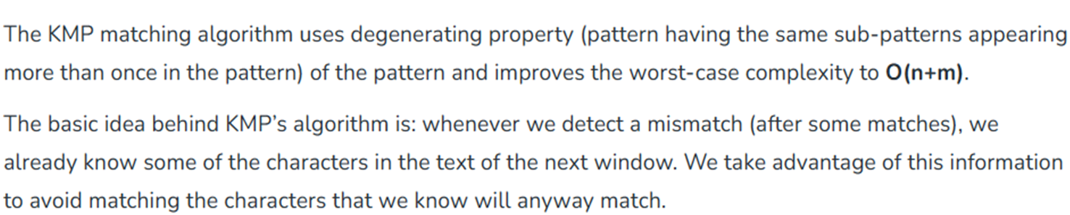

Slide 47
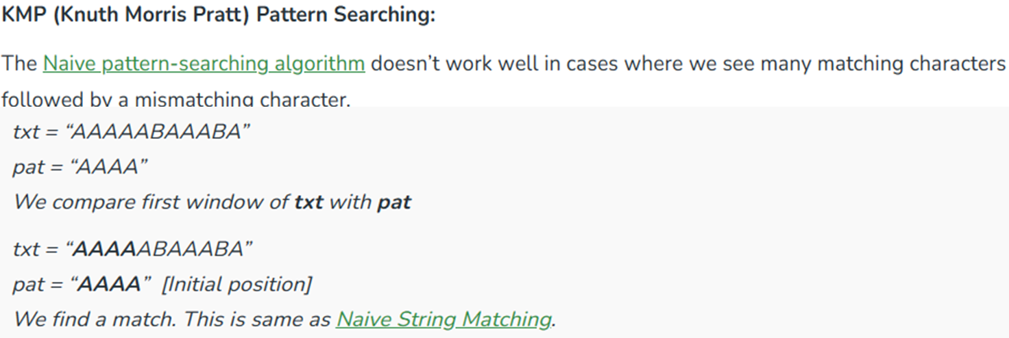

Slide 48
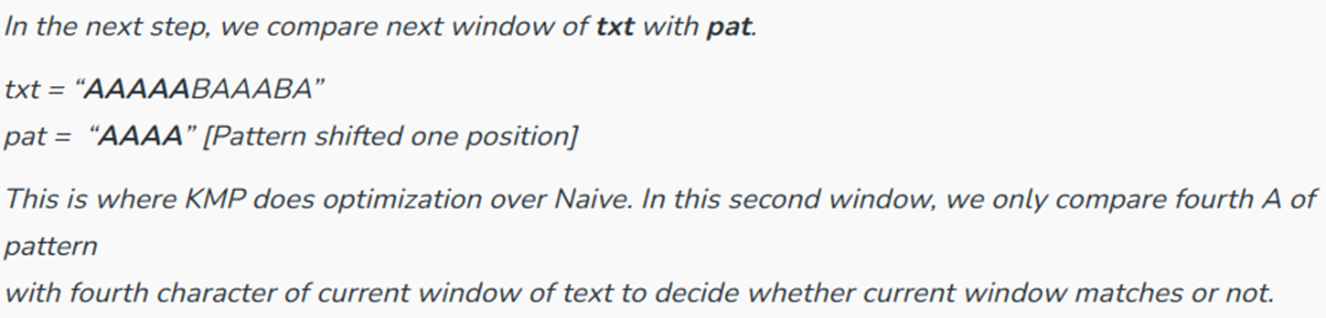

Slide 49
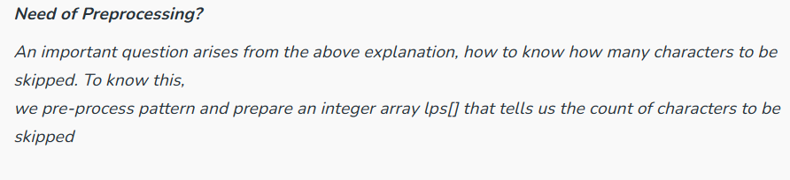

Slide 50
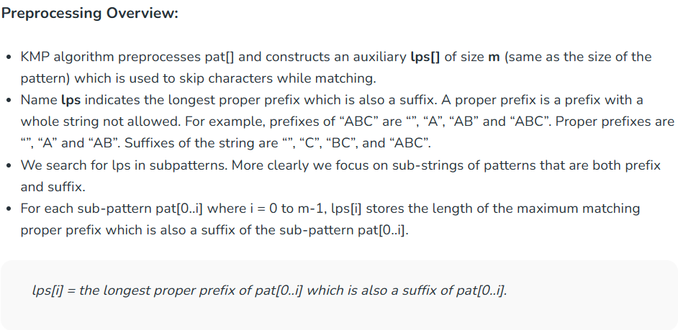

Slide 51
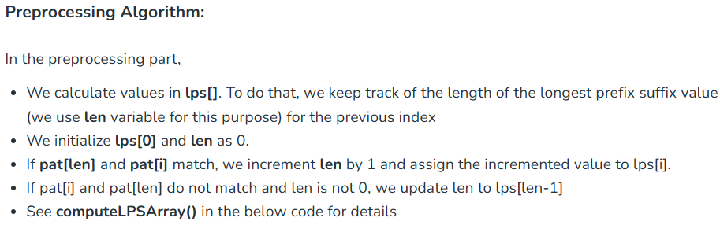

Slide 52
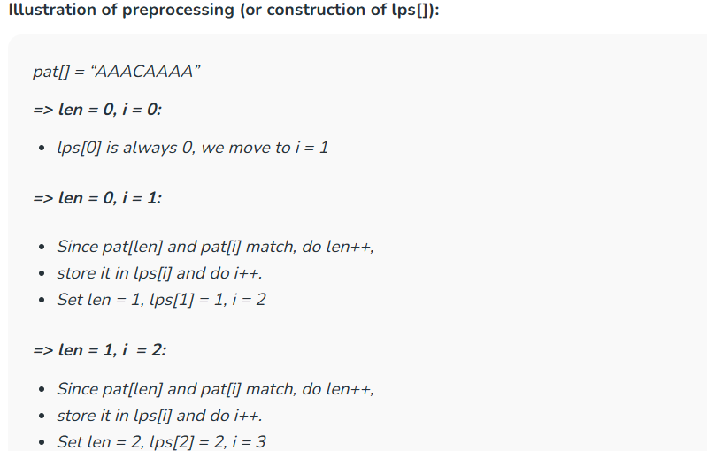

Slide 53
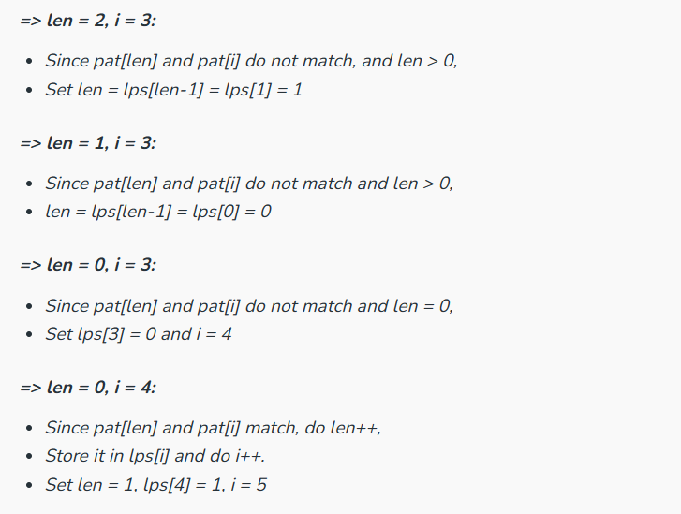

Slide 54
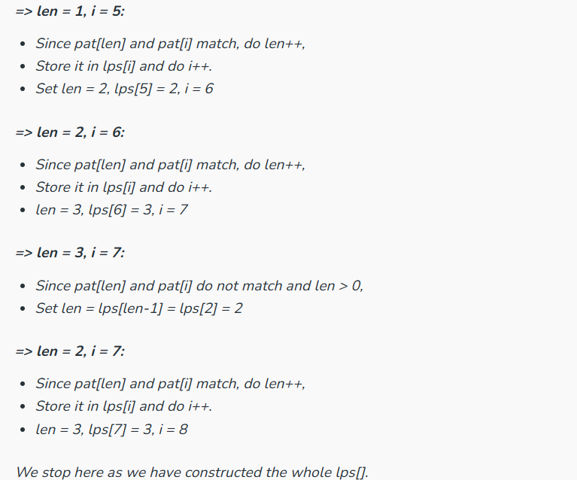

Slide 55
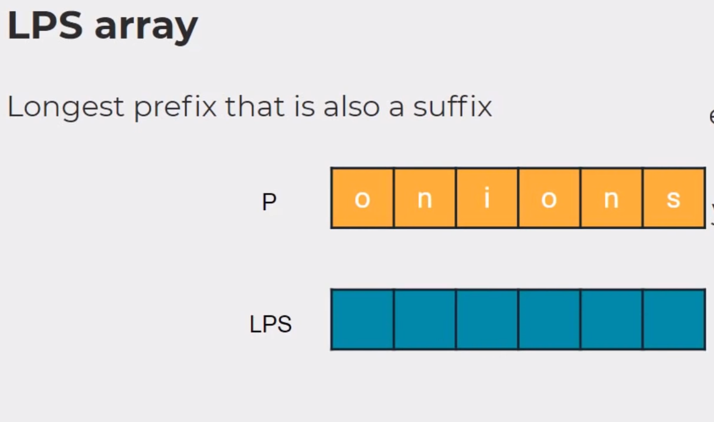

Slide 56
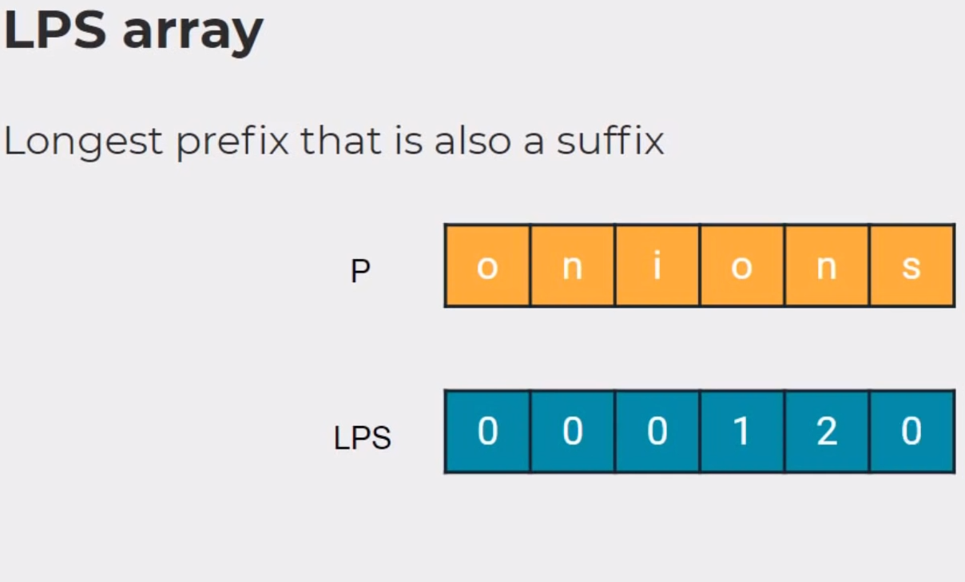

Slide 57
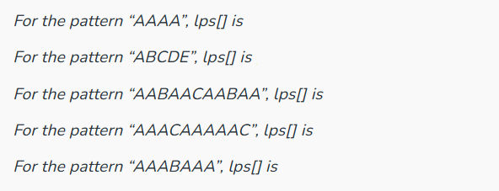

Slide 58
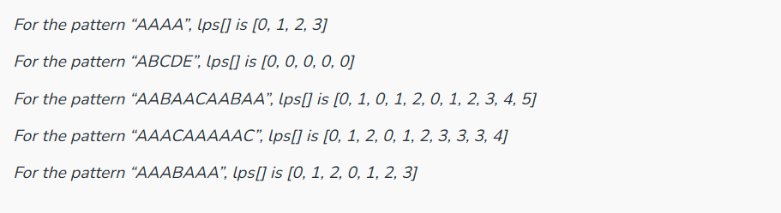

Slide 59
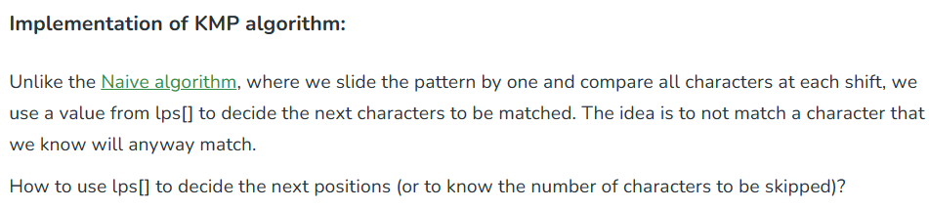

Slide 60
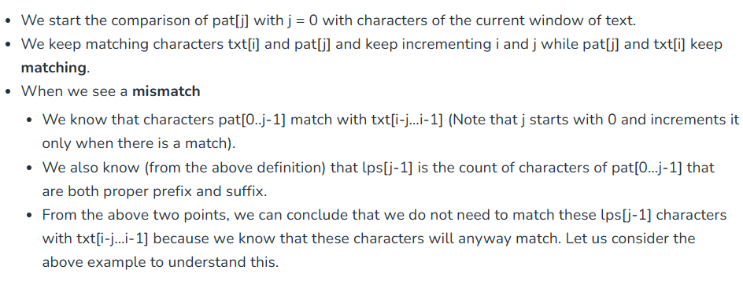

Slide 61
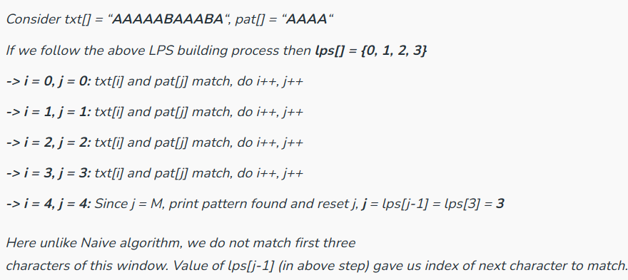
Example 1

Slide 62
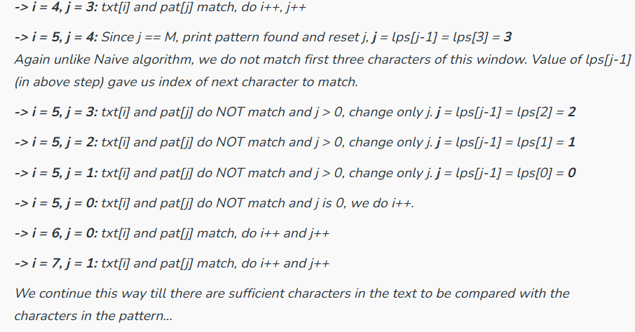
Example 1 continued…

Slide 63
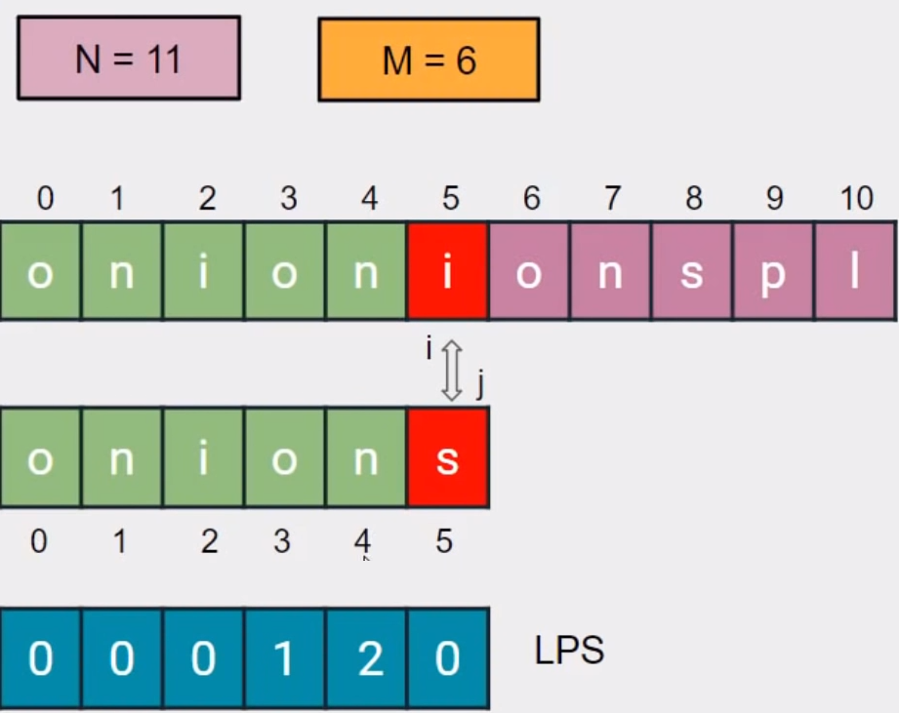
Example 2

Slide 64
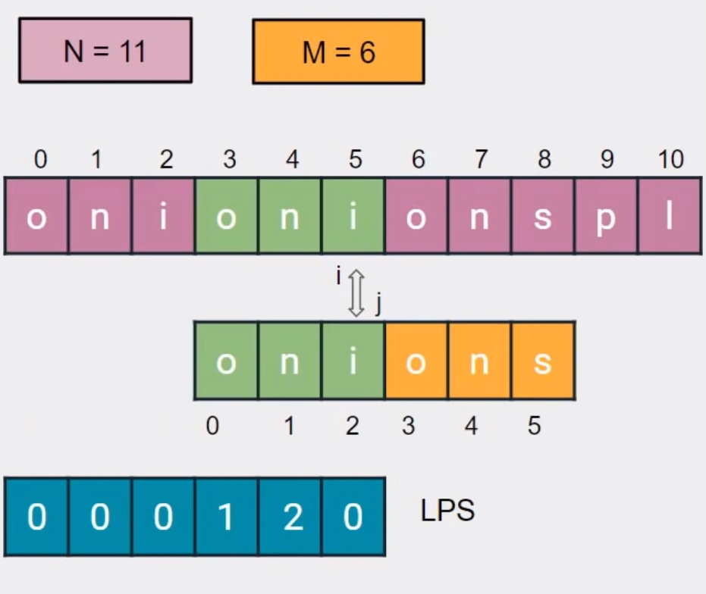
Example 2 continued…

Slide 65
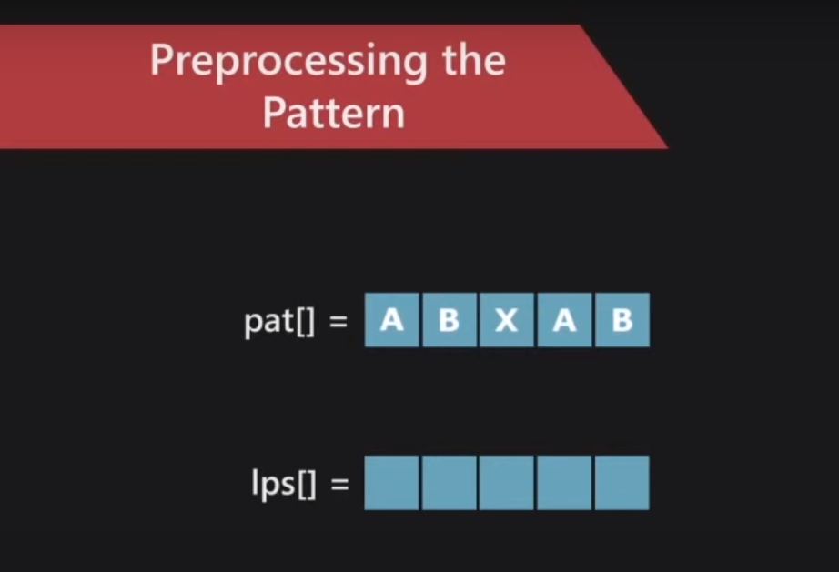
Example 3

Slide 66
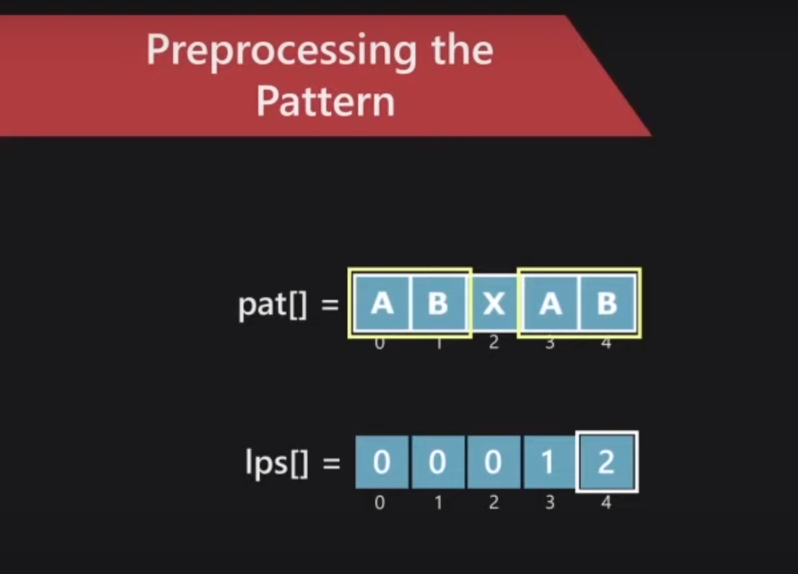
Example 3 continued…

Slide 67
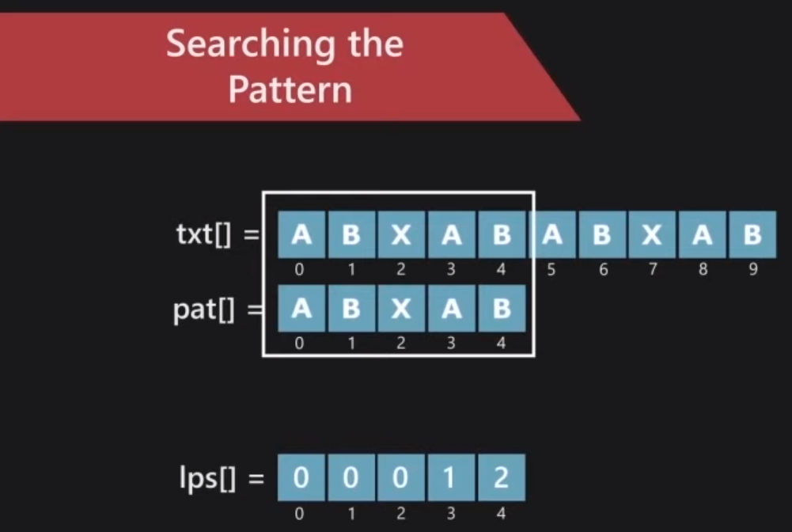
Example 3 continued…

Slide 68
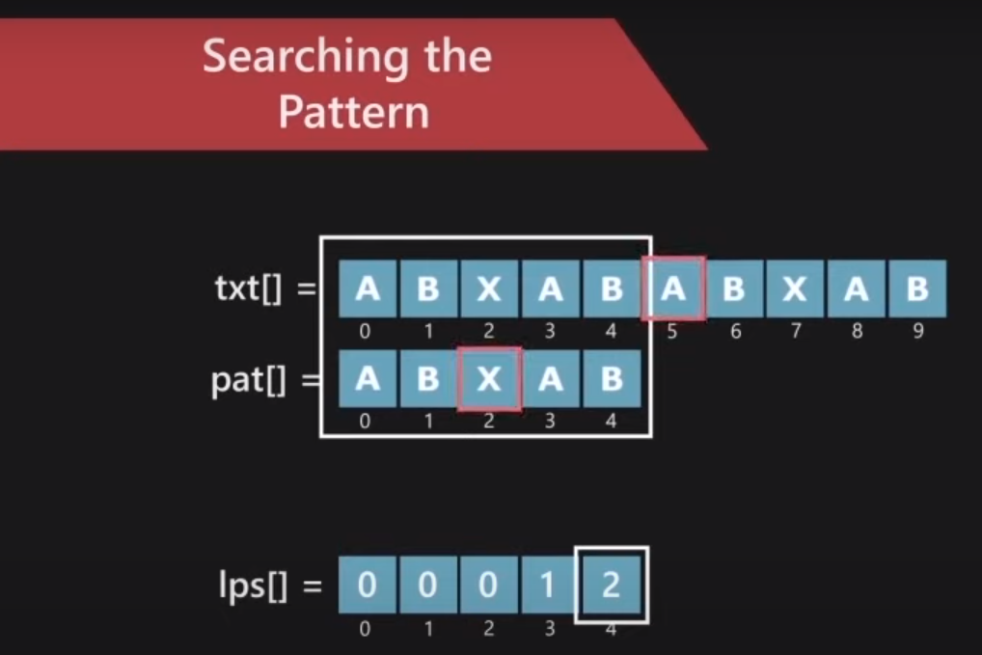
Example 3 continued…

Slide 69
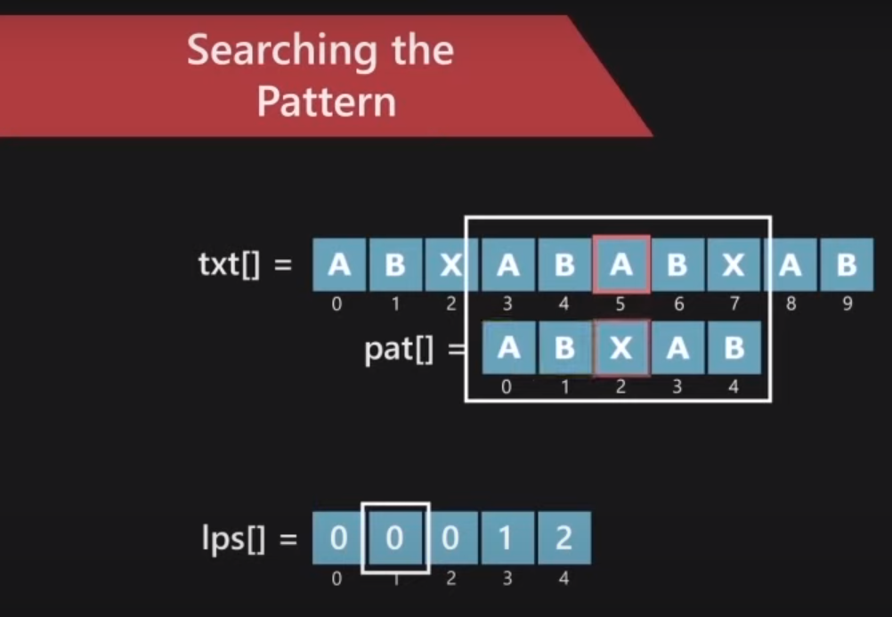
Example 3 continued…

Slide 70
Boyer-Moore Heuristics

Slide 71
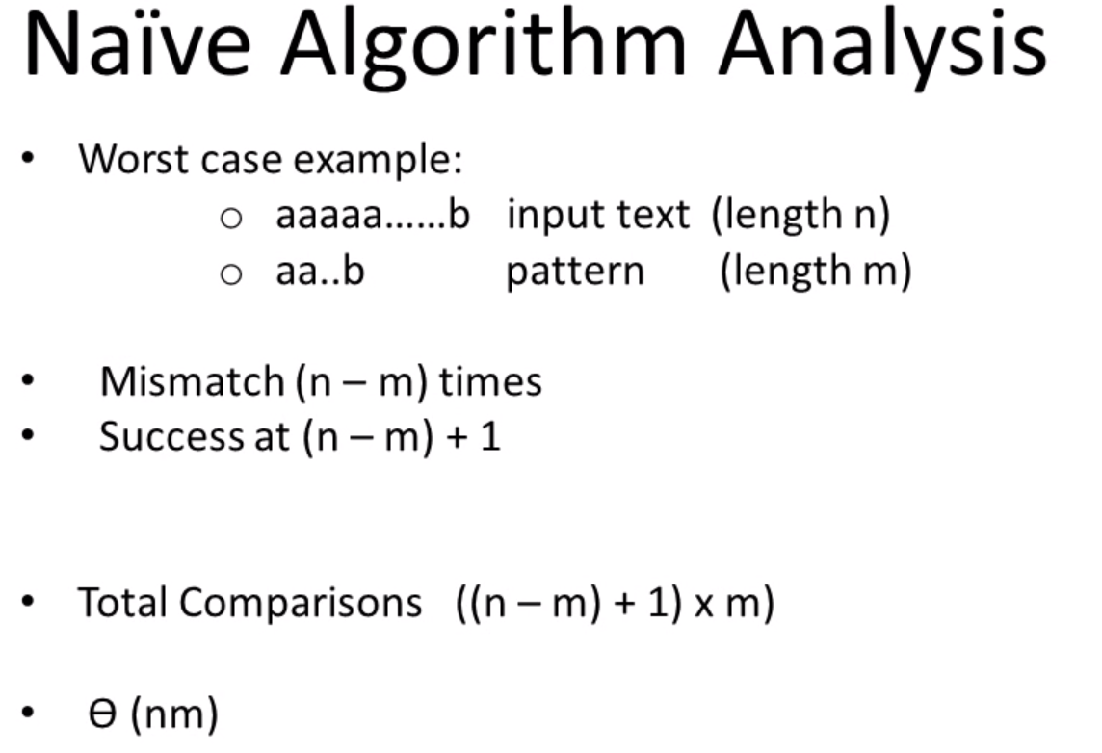

Slide 72
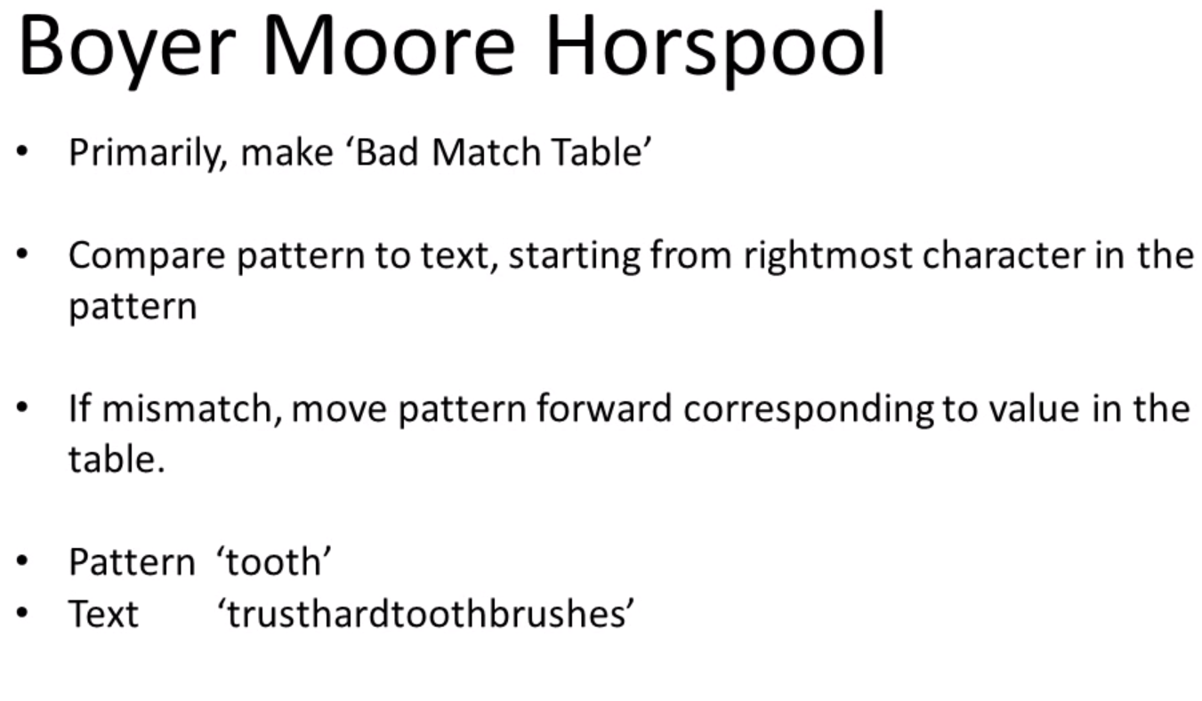

Slide 73
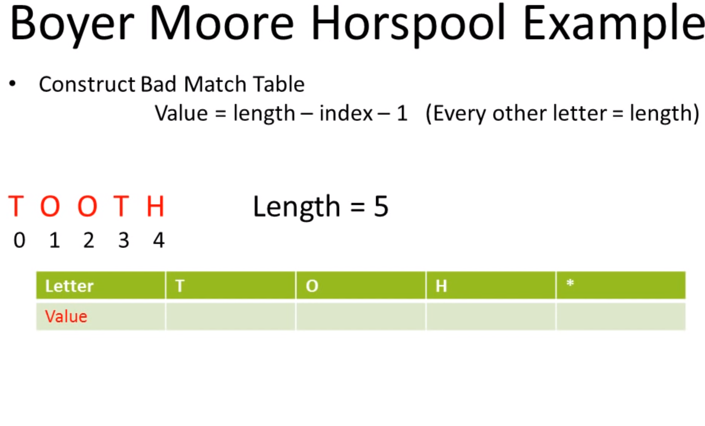

Slide 74
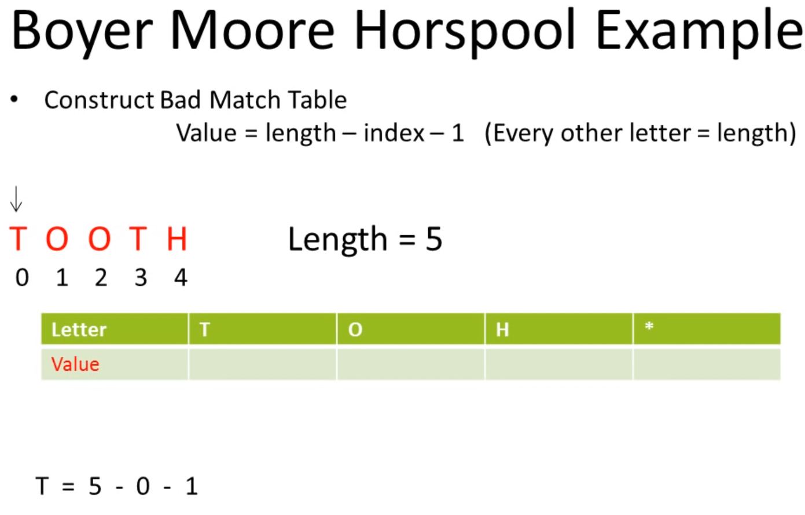

Slide 75


Slide 76


Slide 77


Slide 78


Slide 79


Slide 80


Slide 81


Slide 84
Suffix Arrays

Slide 85
Suffix Arrays: another efficient concept
The suffixes of abaaba are:
L₀ = abaaba$
L₁ = baaba$
L₂ = aaba$
L₃ = aba$
L₄ = ba$
L₅ = a$
L₆ = $
The depth first traversal of the suffix trie(or tree) outputs the suffix sequences as
aaba$, abaaba$, aba$, a$, baaba$, ba$, $
(2, 0, 3, 5, 1, 4, 6)

Slide 86
Suffix Arrays: another efficient concept
A: (2, 0, 3, 5, 1, 4,6) is called the suffix array of the string “abaaba”.
This can be constructed in linear time.
Can be constructed in linear expected time using hashing. (how?)

Slide 87
pattern matching (P)
Find the index j of A such that P is a prefix of L[A[j]] .
Can be done in O(|P| log n) time.

Slide 88
Suffix Tree

Slide 89
Suffix Tries
Suffix tries are a space-efficient data structure to store a string that allows many kinds of queries to be answered quickly.

Slide 90
Let A = a₀a₁a₂ ….. a_{n-1} be a string of length n
Let A_{i} = a_{i}a_{i+1}a₂ ….. a_{n-1} be a suffix A that begins at position i.
A suffix trie of A is made by compressing all the suffixes.

Slide 91


Slide 92


Slide 93


Slide 94


Slide 95


Slide 96


Slide 97
Suffix Trie (1)
The suffix trie of a string X is the compressed trie of all the suffixes of X

Slide 98
Books Recommended
Lipschutz, Seymour, “Data Structures”, Schaum's Outline Series, Tata McGraw Hill.
Gilberg/Forouzan,” Data Structure with C ,Cengage Learning.
Augenstein,Moshe J , Tanenbaum, Aaron M, “Data Structures using C and C++”, Prentice Hall of India

Slide 99
THANK YOU

